Slide 1
Homework 1 FIR Filter
Dr. Yu-Cheng Fan
National Taipei University of Technology, Taipei, Taiwan

Slide 2
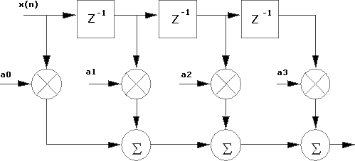
Homework 1: FIR Filter
Write a Verilog Code to describe the FIR Filter.
x[n]
x(n): 8 bits
a0=3’b001
a1=3’b010
a2=3’b011
a3=3‘b100
y[n]: 8 bits
y[n]
Dr. Yu Cheng Fan National Taipei University of Technology Taipei, Taiwan

Slide 3
Homework 1: FIR Filter
Signal Name | I/O | Width | Simple Description
clk | I | 1 | This system is designed to synchronize with the positive edge of the clock.
reset | I | 1 | Active high asynchronous system reset signal.
x | I | 8 | Input data.
y | O | 8 | Output data, this signal doesn’t need to be synchronized with the clock signal.
Dr. Yu Cheng Fan National Taipei University of Technology Taipei, Taiwan

Slide 4
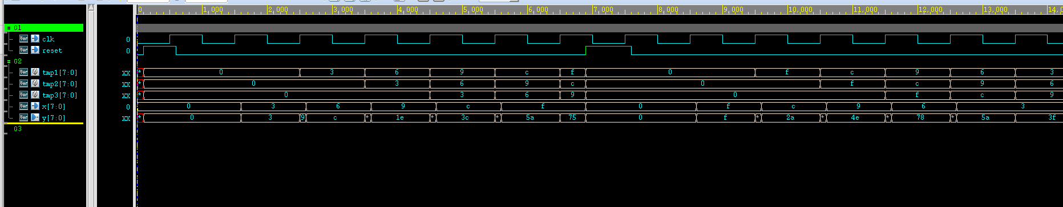
Homework 1: FIR Filter
Command: ncverilog testbench.v FIR.v +access+r +FSDB
Simulation
Command: nWave
View waveform
Dr. Yu Cheng Fan National Taipei University of Technology Taipei, Taiwan

Slide 5
報告繳交格式(參考)
報告撰寫者姓名
報告撰寫者學號
一. 實驗名稱
二. 實驗目的
三. 實驗過程
四. 程式撰寫
五. 模擬結果與分析(附圖)
六. 心得
Dr. Yu-Cheng Fan National Taipei University of Technology Taipei, Taiwan

Slide 6
報告繳交注意事項
報告請勿抄襲，否則零分計算
Lab 1繳交期限為2021年11月14日
若來不及寫完，最後繳交期限為2022年1月9日(分數較低)
報告檔名格式：班級-學號-撰寫人-lab0 例：電子碩一-110368000-吳名氏-lab1.pdf
作業E-mail 至 t109368067@ntut.org.tw
信件主旨為報告檔名 例：電子碩一-110368000-吳名氏-lab1
Dr. Yu Cheng Fan National Taipei University of Technology Taipei, Taiwan

Slide 7

Dr. Yu Cheng Fan National Taipei University of Technology Taipei, Taiwan

